Slide 1


PROJECT FENIKS
Booking/Admin/HR
Week 18
24.01.2019

Slide 2
THE BRIEF
You have been approached by a charity to start an ongoing project to improve the efficiency of record keeping, resource allocation and data analysis.
Your mission (should you choose to accept it) is to build the first phase of the app that will allow entering details of the registration form and persistence of the data using serverless architecture.
The project will be passed on to subsequent teams, so documentation of resources is important.

Slide 3
THE PROBLEM
Manual forms:
Registration
Equalities
Assessment
Manual booking and scheduling system.
Manual data analysis with Excel.

Slide 4
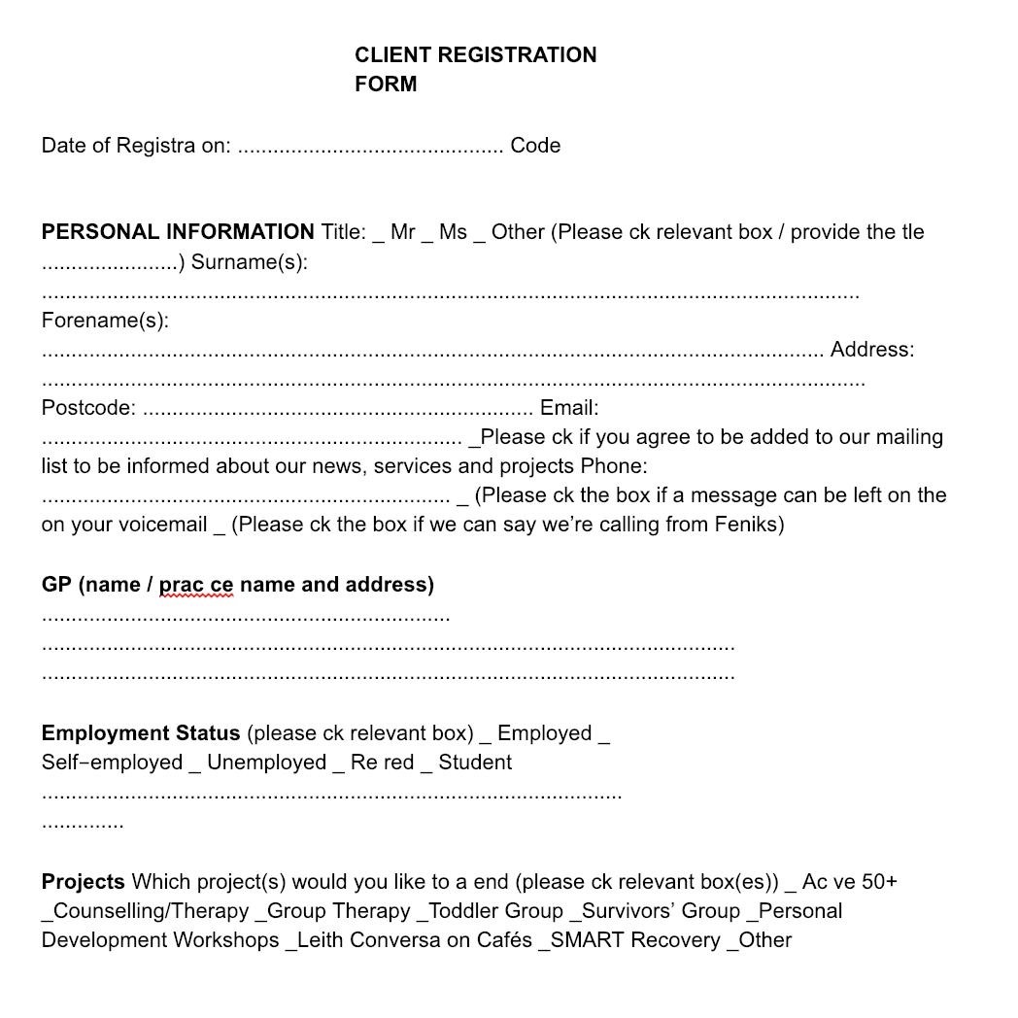

Slide 5
THE MVP
A user should be able to:
Open a web app on a laptop.
Submit the registration form.
View the client details.

Slide 6
OUT OF SCOPE (This time)
We weren’t expecting to deal with:
Authentication
Authorisation
Multi user views
Scheduling/ Booking
Data analysis
Automated email reminders

Slide 7
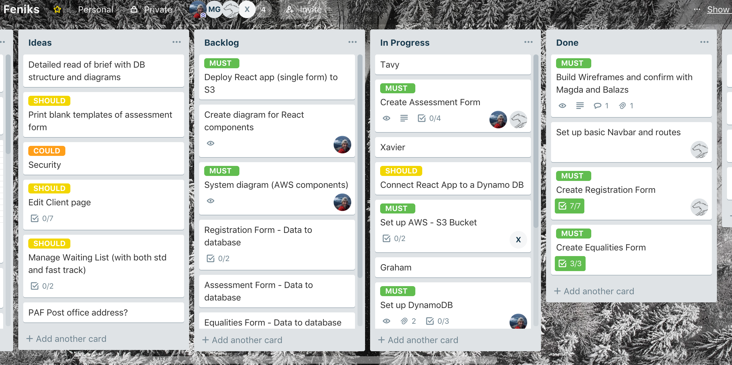

Slide 8
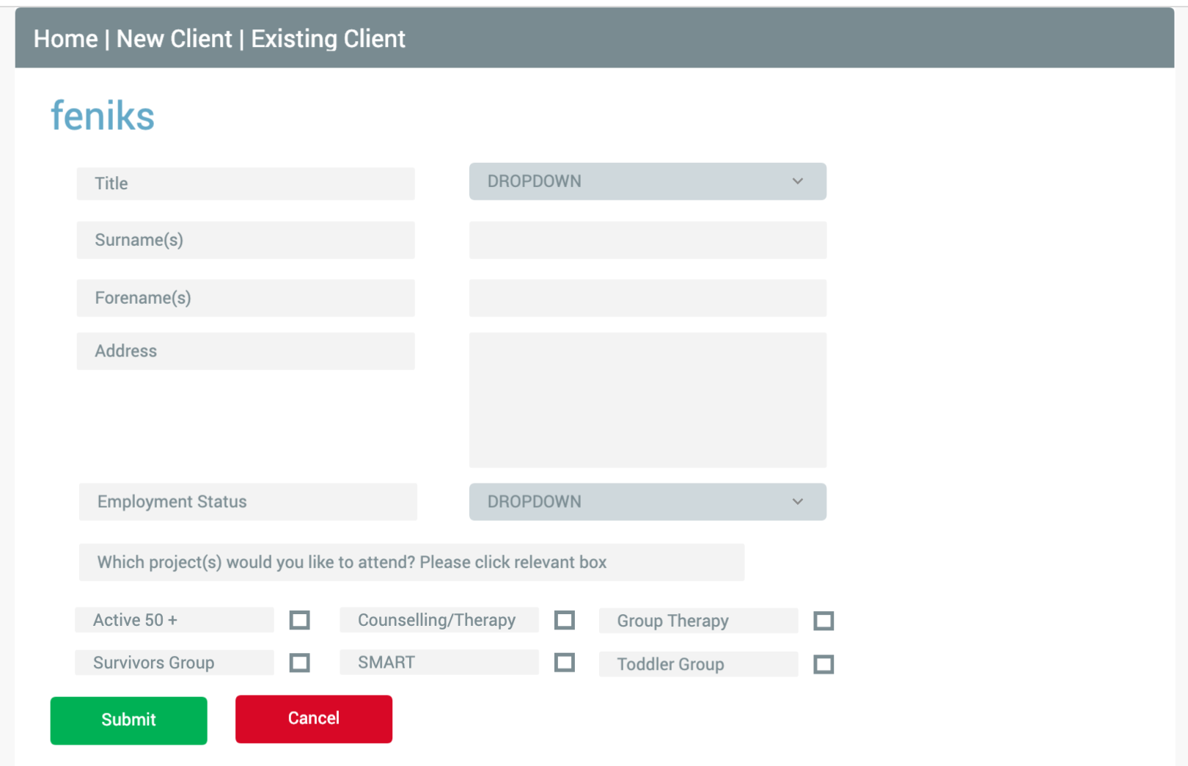
Fluid UI

Slide 9
Diagram of react app components

Slide 10
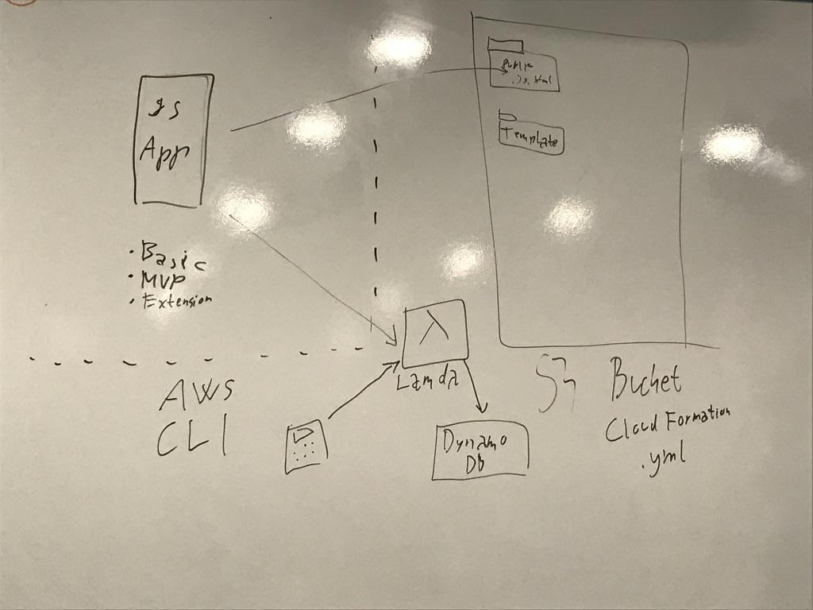
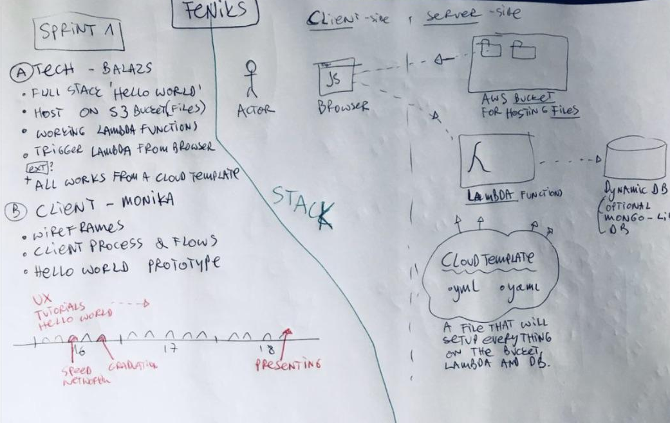
OUR INTRO TO SERVERLESS

Slide 11
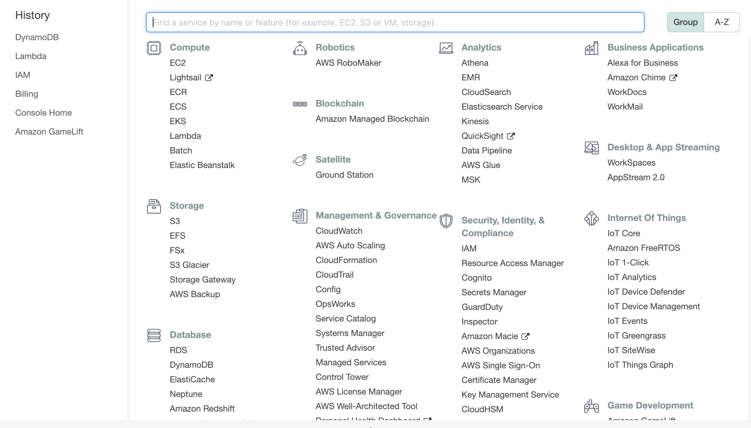

Slide 12
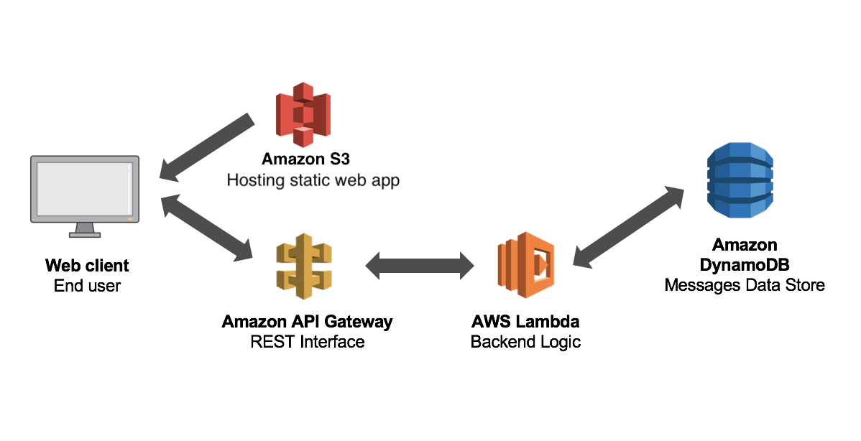
AWS Components

Slide 13
How did we get on?

Slide 14
MVP
A user should be able to:
Complete a registration form
View all clients
View details of one client
Persist data to the DB
Deploy all functionality to the cloud

Slide 15
THINGS THAT WENT WELL
COLLABORATION
Despite Job hunting and interviews, comms were maintained well with a combination of Slack, Trello, Google Docs.
RESEARCH
Lots of problem solving for patterns and new ways of doing things (beyond our understanding)
Additional AWS resources.
The subject was raised in some interviews so it was useful to have some awareness of AWS.
WIREFRAMING
Fluid UI helped to demonstrate a very basic but interactive prototype of the UI.

Slide 16
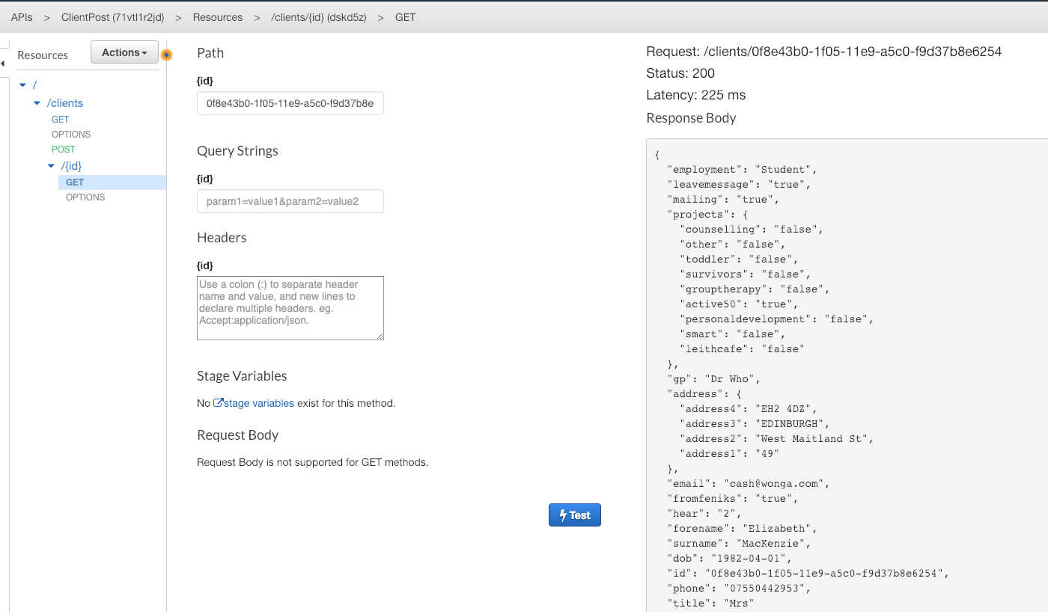
BEST PROJECT MOMENT!!!!

Slide 17
THINGS THAT WENT LESS WELL
DIVISION OF WORK
Difficult to access AWS resources without a central account.
AWS is a BIG, fiddly subject and a steep learning curve.
AWS COMPONENT INTEGRATION
Each integration between components took longer than expected.
DISTRACTION
Job hunting is stressful and very distracting.

Slide 18
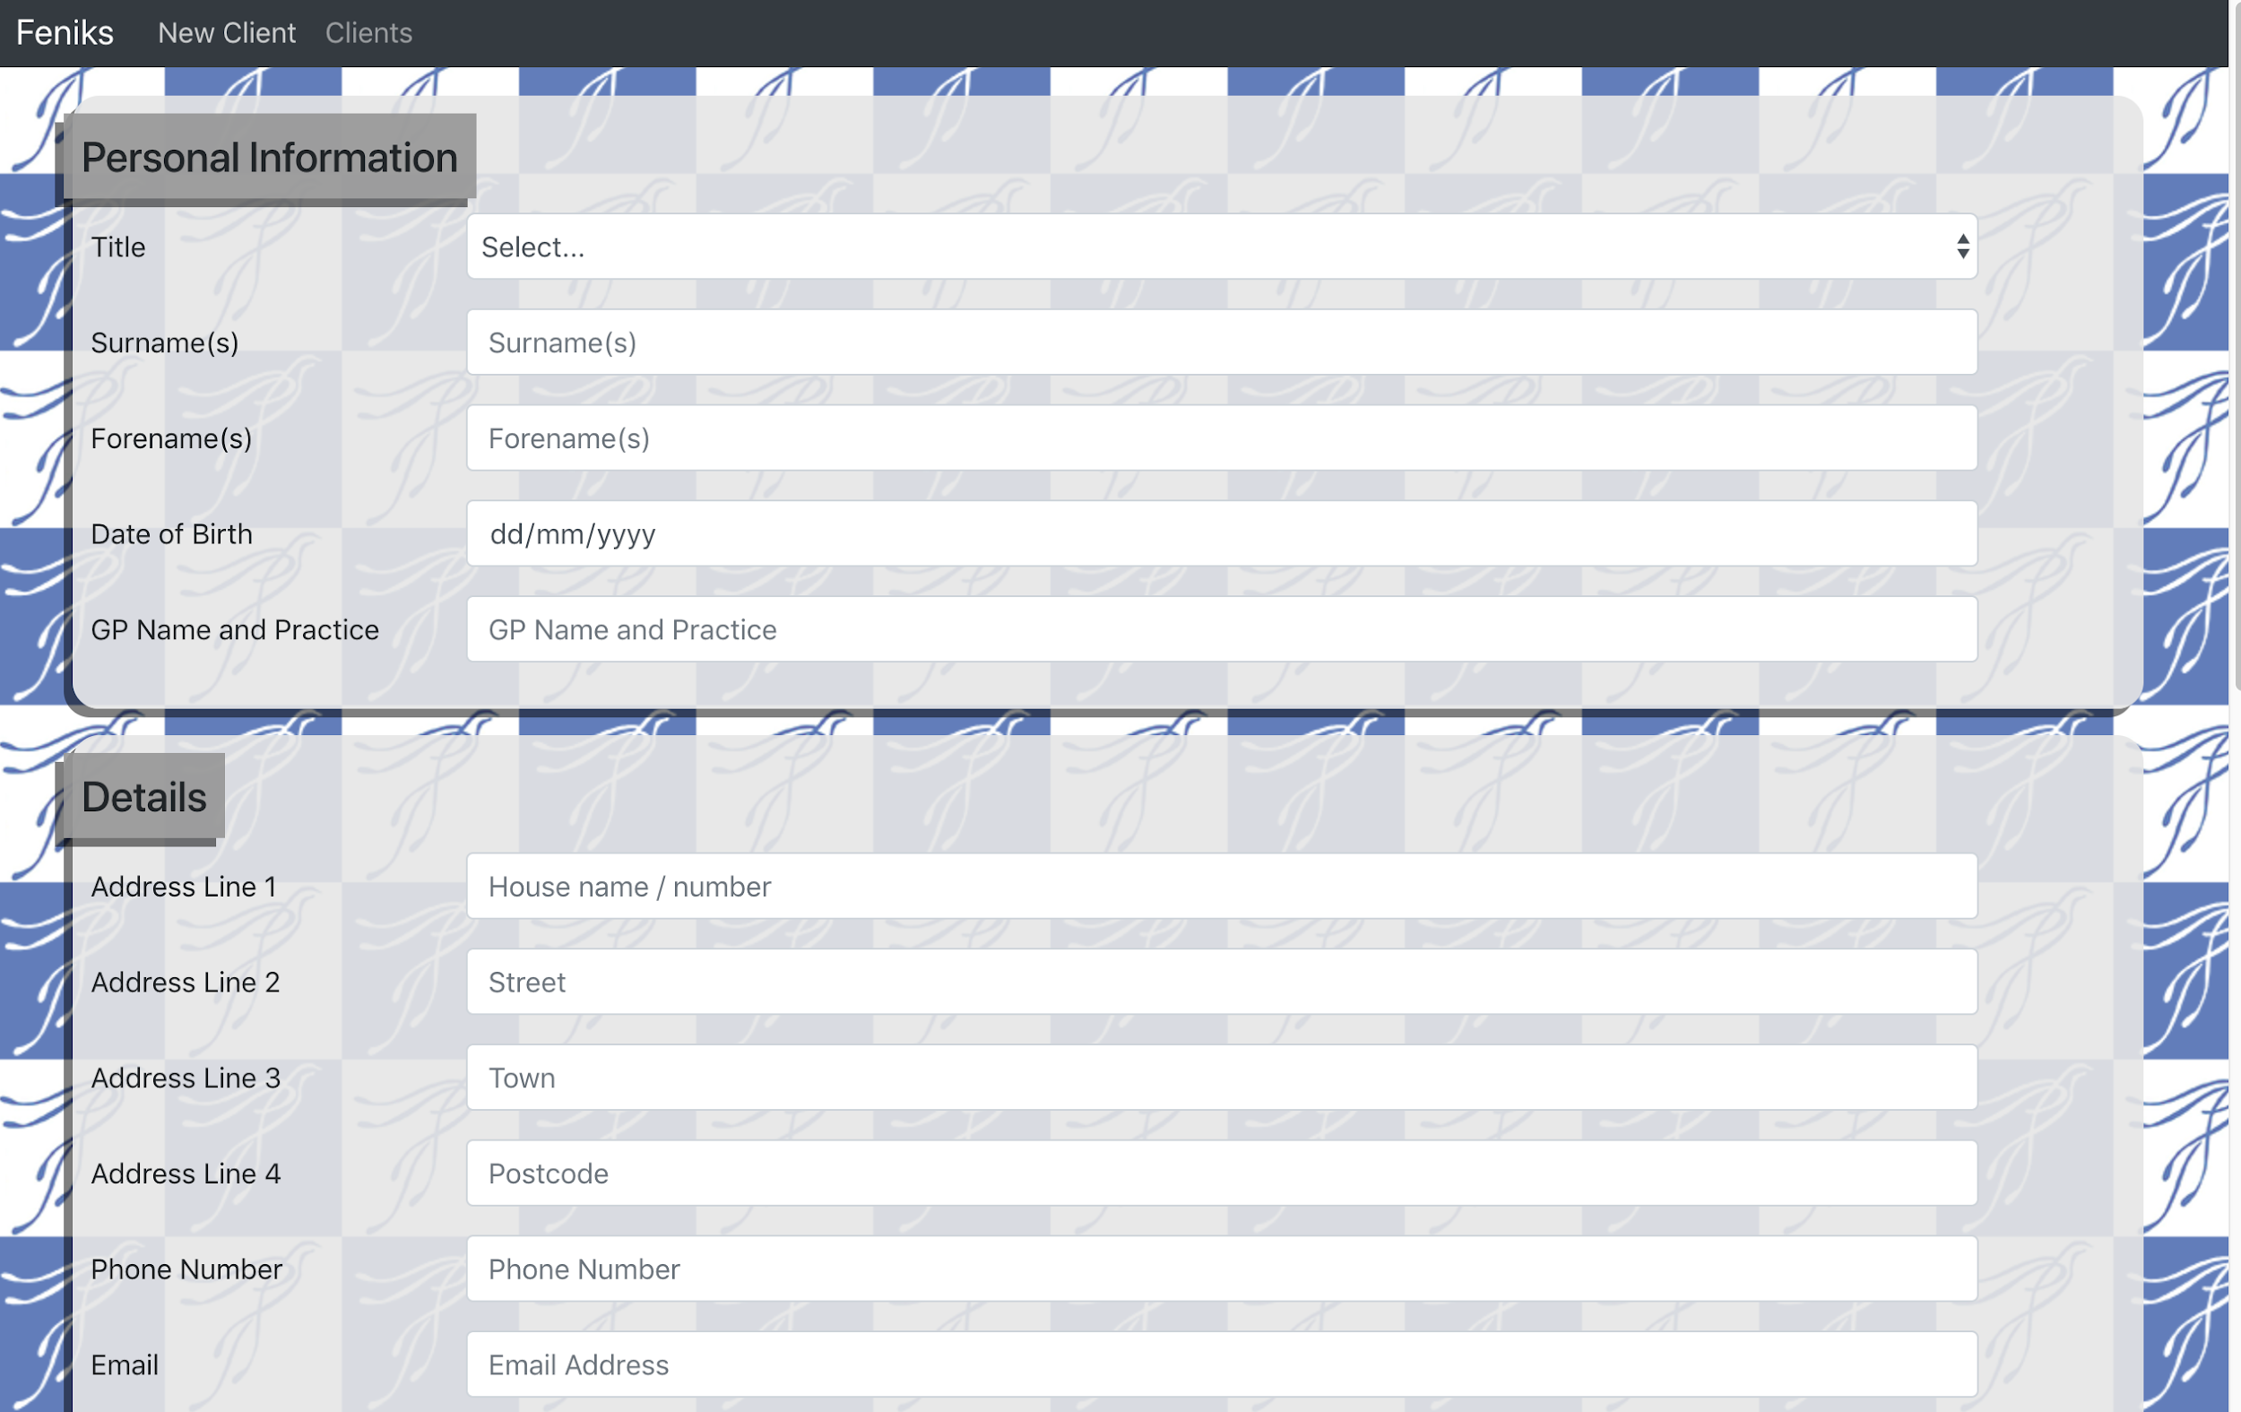
DEMO

Slide 19
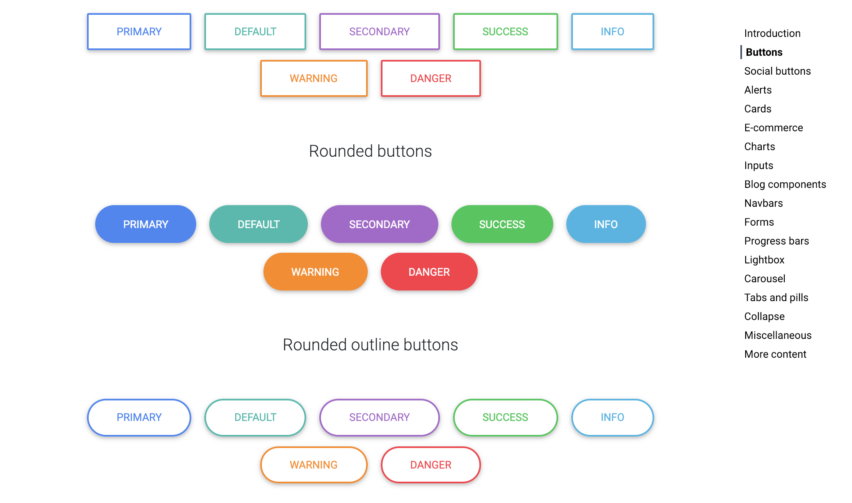
Code that we like: Tavy
MDBOOTSTRAP.com
Bootstrap 4 with React & Material Design
A JavaScript library for building user interfaces based on Bootstrap 4 & Google Design principles
‹#›

Slide 20
Code that we like: Xavier
AWS?
‹#›

Slide 21
Code that we like: Michael
‹#›

Slide 22
Future work
Complete CRUD functionality in Lambda Functions.
Update
Delete
Booking system.
Print assessment form as PDF
Authentication
Authorisation
Filter by projects / groups
Add audit functionality for GDPR compliance
Change log
Time of edit
Identity of editor etc
More...
‹#›

Slide 23
Thanks
Tony & Pawel
Magda
Balazs
‹#›

Slide 24
Questions?
‹#›

Slide 25
OUR RESOURCES
THE TEAM
Developed and presented by Project Feniks:
Tavy Fraser
Xavier Godard
Michael Griffin
Graham Stein
Trello: https://trello.com/invite/b/K6p17DsZ/440f3989071c83b824b1354f1ab563ec/feniks
GoogleDrive: https://drive.google.com/open?id=1sVGcGsJ6ELQKWwe_hXlG_fKn6azG1_w-ZwjTcP90ZMg
Github: https://github.com/xavgo134/Feniks-Project

